Slide 1

Foundations & Configuration Management
Deployment and Automation Essentials

Slide 2

Unit 1: Deployment Fundamentals
Deployment is the process of getting applications and services running in their target environments. It can range from manual steps to fully automated pipelines.
Manual vs. Automated: Manual deployments are error-prone and slow; automation ensures speed and repeatability.
Key Challenges: Dependency management, environment drift, rollback complexity.
CI/CD Concepts: Continuous Integration (CI) for frequent code merges, Continuous Delivery/Deployment (CD) for automated release cycles.

Slide 3
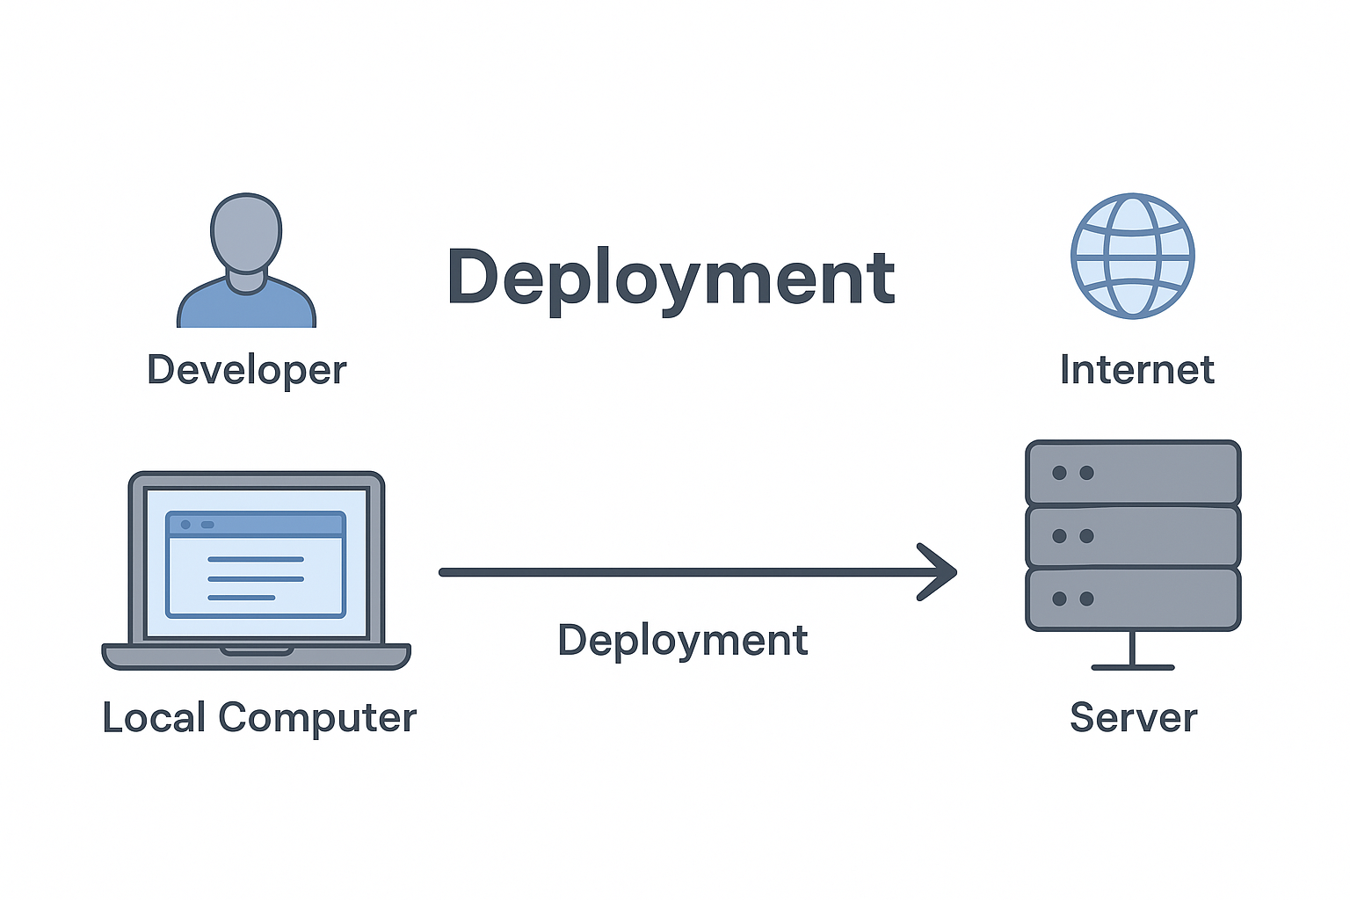
Is pushing code to GitHub considered deployment?
No, It's version control, not server deployment.
Is uploading a YouTube video considered deployment?
No, It's content publishing, not software deployment.
Is uploading a file to Google Drive considered hosting?
No, It’s storage, not web hosting.
Is pushing code to Vercel considered deployment?
Yes, Vercel deploys code to live servers.

Slide 4
No, It's version control, not server deployment.
Is pushing code to GitHub considered deployment?
Is uploading a YouTube video considered deployment?
No, It's content publishing, not software deployment.
Is uploading a file to Google Drive considered hosting?
No, It’s storage, not web hosting.
Is pushing code to Vercel considered deployment?
Yes, Vercel deploys code to live servers.

Slide 5
Is pushing code to GitHub considered deployment?
No, It's version control, not server deployment.
No, It's content publishing, not software deployment.
Is uploading a YouTube video considered deployment?
Is uploading a file to Google Drive considered hosting?
No, It’s storage, not web hosting.
Is pushing code to Vercel considered deployment?
Yes, Vercel deploys code to live servers.

Slide 6
Is pushing code to GitHub considered deployment?
No, It's version control, not server deployment.
Is uploading a YouTube video considered deployment?
No, It's content publishing, not software deployment.
No, It’s storage, not web hosting.
Is uploading a file to Google Drive considered hosting?
Is pushing code to Vercel considered deployment?
Yes, Vercel deploys code to live servers.

Slide 7
Is pushing code to GitHub considered deployment?
No, It's version control, not server deployment.
Is uploading a YouTube video considered deployment?
No, It's content publishing, not software deployment.
Is uploading a file to Google Drive considered hosting?
No, It’s storage, not web hosting.
Yes, Vercel deploys code to live servers.
Is pushing code to Vercel considered deployment?

Slide 8
DevOps Deployment Tool Characteristics
Is pushing code to GitHub considered deployment?
No, It's version control, not server deployment.
Is uploading a YouTube video considered deployment?
No, It's content publishing, not software deployment.
Is uploading a file to Google Drive considered hosting?
No, It’s storage, not web hosting.
Is pushing code to Vercel considered deployment?
Yes, Vercel deploys code to live servers.

Slide 9
DevOps Deployment Tool Characteristics
Automation | A team manually deploys code every Friday night, leading to fatigue and frequent errors. | CI/CD pipelines (e.g., GitHub Actions) automate builds and deployments, reducing human error and freeing weekends.
Repeatability | Code works in dev but breaks in staging due to inconsistent environment setup. | Tools like Docker ensure identical environments across dev, staging, and prod.
Version Control Integration | A hotfix is deployed manually without tracking, and no one knows what changed. | Git-integrated tools (e.g., ArgoCD) deploy only from tracked commits, ensuring traceability.
Rollback Capability | A new release crashes the app, and restoring the previous version takes hours. | Tools like Spinnaker enable one-click rollback to the last stable deployment.
Environment Management | Secrets are hardcoded in scripts and accidentally pushed to GitHub. | Deployment tools use secret managers (e.g., Vault, AWS Secrets Manager) to inject secrets securely.
Scalability | A sudden traffic spike crashes the server during a product launch. | Kubernetes + Helm charts allow auto-scaling deployments to handle load dynamically.
Automation
Repeatability
Version Control Integration
Rollback Capability
Environment Management
Scalability

Slide 10
Automation | A team manually deploys code every Friday night, leading to fatigue and frequent errors. | CI/CD pipelines (e.g., GitHub Actions) automate builds and deployments, reducing human error and freeing weekends.
Repeatability | Code works in dev but breaks in staging due to inconsistent environment setup. | Tools like Docker ensure identical environments across dev, staging, and prod.
Version Control Integration | A hotfix is deployed manually without tracking, and no one knows what changed. | Git-integrated tools (e.g., ArgoCD) deploy only from tracked commits, ensuring traceability.
Rollback Capability | A new release crashes the app, and restoring the previous version takes hours. | Tools like Spinnaker enable one-click rollback to the last stable deployment.
Environment Management | Secrets are hardcoded in scripts and accidentally pushed to GitHub. | Deployment tools use secret managers (e.g., Vault, AWS Secrets Manager) to inject secrets securely.
Scalability | A sudden traffic spike crashes the server during a product launch. | Kubernetes + Helm charts allow auto-scaling deployments to handle load dynamically.
DevOps Deployment Tool Characteristics
A team manually deploys code every Friday night, leading to fatigue and frequent errors.
CI/CD pipelines (e.g., GitHub Actions) automate builds and deployments, reducing human error and freeing weekends.
Automation
Repeatability
Code works in dev but breaks in staging due to inconsistent environment setup.
Tools like Docker ensure identical environments across dev, staging, and prod.
Version Control Integration
A hotfix is deployed manually without tracking, and no one knows what changed.
Git-integrated tools (e.g., ArgoCD) deploy only from tracked commits, ensuring traceability.
Rollback Capability
A new release crashes the app, and restoring the previous version takes hours.
Tools like Spinnaker enable one-click rollback to the last stable deployment.
Environment Management
Secrets are hardcoded in scripts and accidentally pushed to GitHub.
Deployment tools use secret managers (e.g., Vault, AWS Secrets Manager) to inject secrets securely.
A sudden traffic spike crashes the server during a product launch.
Kubernetes + Helm charts allow auto-scaling deployments to handle load dynamically.
Scalability

Slide 11



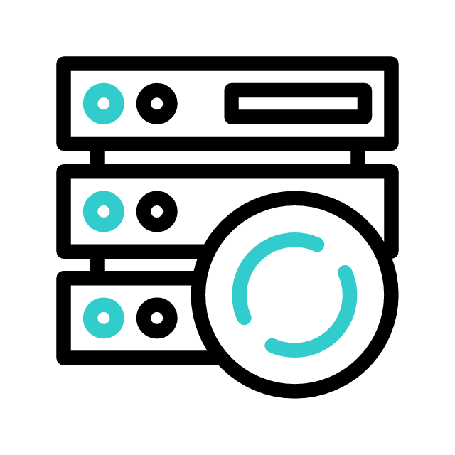


Benefits of
Deployment
Tools
1. Automation of Deployments
Every Friday, a junior developer named Vidhi manually SSHs into the server, uploads files, and restarts services. One day, she forgets a config file and the app crashes during peak hours.
After switching to GitHub Actions, deployments happen automatically after code merges—no missed steps, no late-night fixes.

Slide 12




Benefits of
Deployment
Tools
2. Consistency Across Environments
A team builds a feature that works perfectly on their local machines. But when deployed to staging, it throws errors due to missing dependencies.
They adopt Docker and Kubernetes, ensuring every environment runs the same container image.

Slide 13

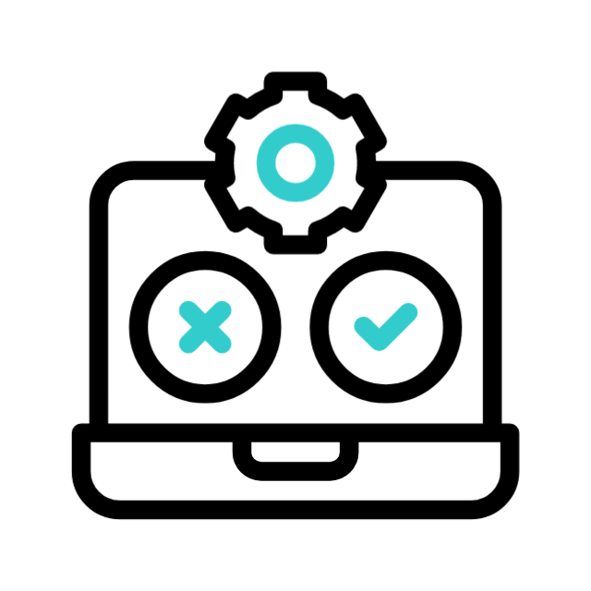




Benefits of
Deployment
Tools
3. Last one, Faster Release Cycles
A startup wants to push updates weekly, but manual testing and deployment take days. Their competitors are moving faster.
They set up Jenkins pipelines with automated tests and deploy daily.

Slide 14
Benefits of
Deployment
Tools
4. Rollback Capability
9. Scalability & Load Handling
5. Reduced Human Error
10. Integration with CI/CD
6. Improved Collaboration
11. Version Tracking & Audit Logs
7. Security & Access Control
12. Multi-Cloud & Hybrid Support
8. Monitoring & Feedback Loops

Slide 15
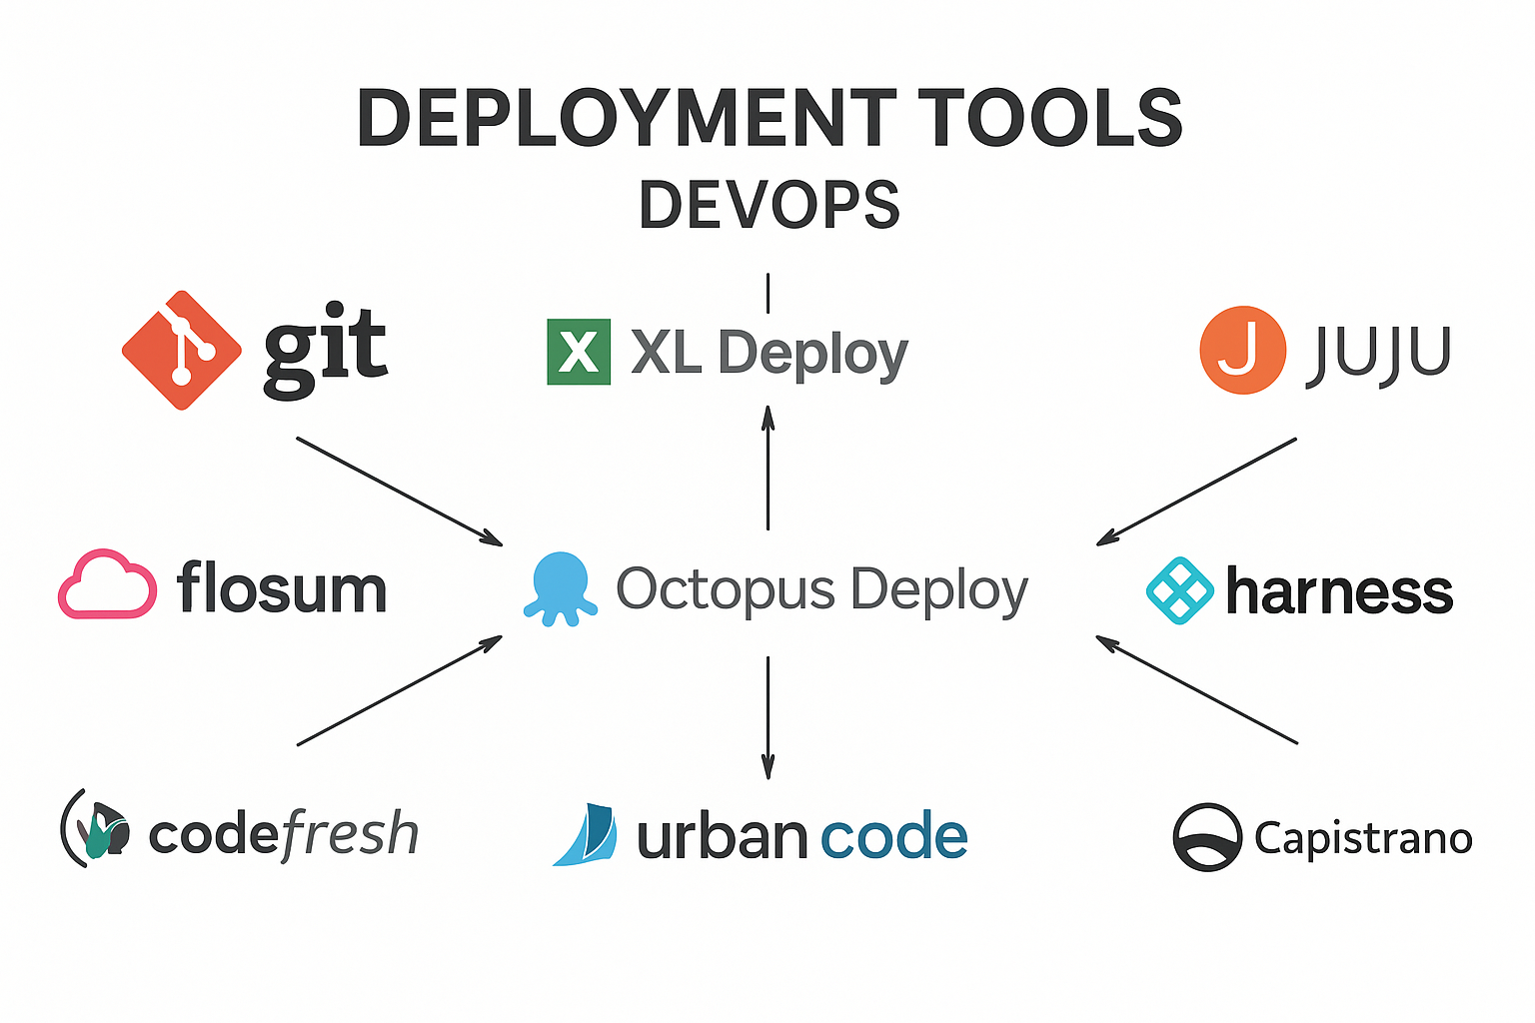
Is pushing code to GitHub considered deployment?
No, It's version control, not server deployment.
Is uploading a YouTube video considered deployment?
No, It's content publishing, not software deployment.
Is uploading a file to Google Drive considered hosting?
No, It’s storage, not web hosting.
Is pushing code to Vercel considered deployment?
Yes, Vercel deploys code to live servers.

Slide 16



Tool Demo: GitHub Actions
GitHub Actions is a powerful, flexible CI/CD platform integrated directly into GitHub repositories, enabling automated workflows right where your code lives.
Overview
YAML Workflows
Setup Steps
Event-driven automation triggered by repository activities.
Define jobs, steps, and actions in intuitive YAML files.
Create .github/workflows/ directory, define your .yml file.
Simple CI/CD Pipeline:

Slide 17
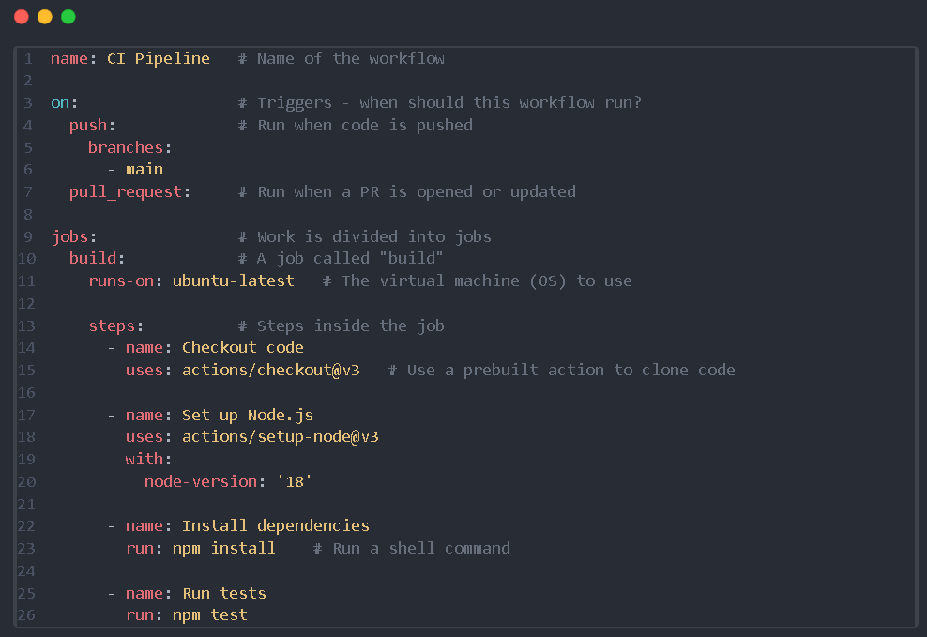
YAML Format (Configuration File)

Slide 18
1. app.py def add(a, b):
return a + b
if __name__ == "__main__":
print("2 + 3 =", add(2, 3))
2. test_app.py from app import add
def test_add():
assert add(2, 3) == 5 3. requirements.txt: pytest
Github Actions HANDS-ON:
Step 1: Prerequisites needed
Git, Python, GitHub Account
Step 2: Create a GitHub repository
Step 3: Clone it locally
Step 4: Add a sample project
Windows (PowerShell):
py -3 -m venv .venv
.venv\Scripts\activate.bat
python -m pip install -r requirements.txt
python -m pytest -q
macOS/Linux:
python3 -m venv .venv
source .venv/bin/activate
python -m pip install -r requirements.txt
python -m pytest -q
Step 5: Create a virtual environment and run tests
Step 6: Commit and push code
Step 7: Add GitHub Actions workflow (YAML) in local code
- .github/workflows/ci.yml - .yml in next slide…. - Then commit changes and validate the ‘Actions’
Git add .
Git commit –m “Add sample project”
Git push origin main

Slide 19
name: CI
on:
push:
branches: [ "main" ]
pull_request:
branches: [ "main" ]
jobs:
test:
runs-on: ubuntu-latest
steps:
- name: Check out code
uses: actions/checkout@v4
- name: Set up Python
uses: actions/setup-python@v5
with:
python-version: "3.11"
- name: Install dependencies
run: |
python -m pip install --upgrade pip
if [ -f requirement.txt ]; then pip install -r requirement.txt; fi
- name: Run tests
run: python -m pytest -q

Slide 20

Unit 2: Ansible Introduction
Ansible is an open-source automation engine that automates provisioning, configuration management,
application deployment, orchestration, and many other IT needs.
What is Ansible? A powerful, agentless automation tool for system administration tasks.
Agentless Model: Connects over SSH (Linux/Unix) or WinRM (Windows) – no client software needed on managed nodes.
Push-Based Automation: Commands are "pushed" from a central control node to target machines.
Simplicity: Uses YAML for playbooks, making it human-readable and easy to learn.

Slide 21
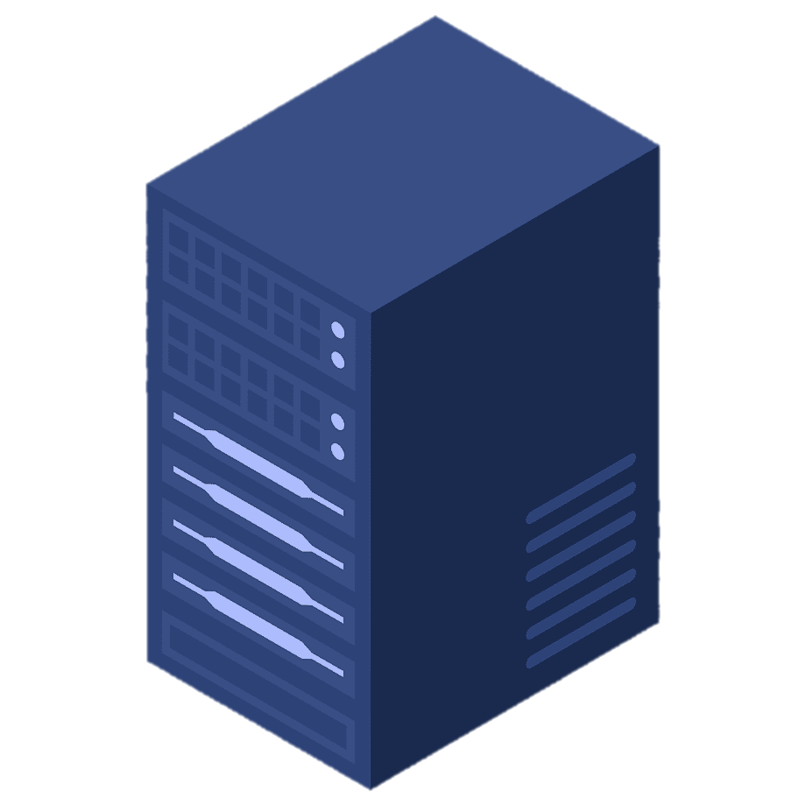
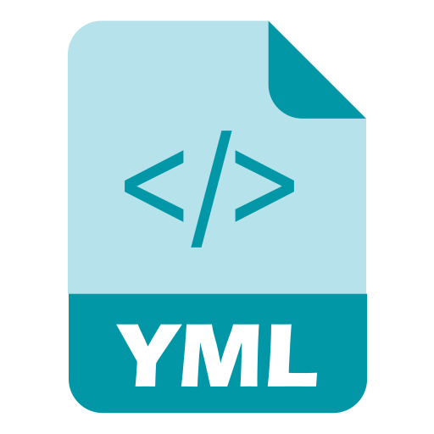



Unit 2: Ansible Introduction
Ansible is an open-source automation engine that automates provisioning, configuration management, application deployment,
orchestration, and many other IT needs.
Managed Nodes 3
Managed Nodes 2
Managed Nodes 4
Managed Nodes 1
Managed Nodes 5
Playbook
Manual SSH-ing
“” “”
“” “”
Manual SSH-ing
“” “”
With Ansible:
One-click automation
Version-controlled infrastructure
Faster recovery & updates
Today, I have been assigned to install Apache in all of these servers
Without Ansible:
Manual repetition
Inconsistent setups
Hard to scale
Inventory
Control Node

Slide 22
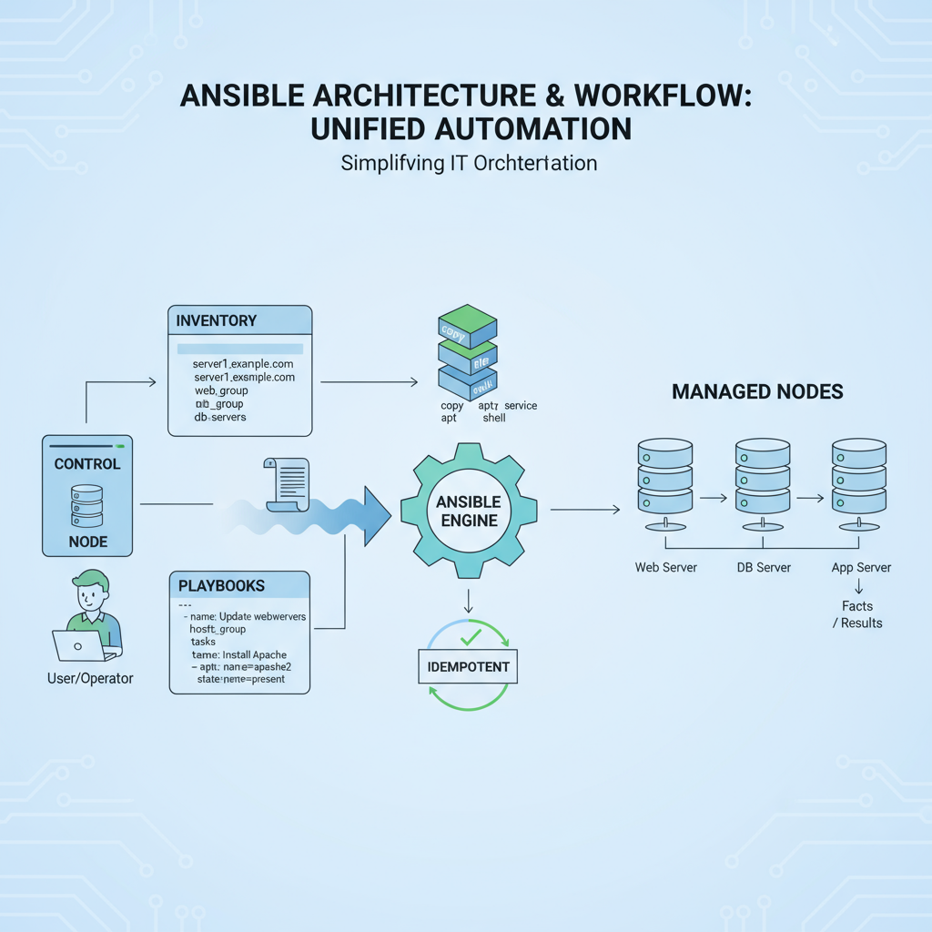
Ansible Architecture
KEY CONCEPTS:
Control Node → where Ansible is installed (your Windows machine with WSL2).
Managed Nodes → servers that Ansible controls (can be localhost, a Linux VM, or Docker container).
Inventory → a file listing managed nodes.
Modules → reusable units (e.g., install package, create file).
Playbook → YAML script describing tasks.
Idempotent → running same playbook multiple times gives same result.

Slide 23
Ansible Playbooks & YAML
Playbooks are the heart of Ansible, defining automation tasks in a structured, human-readable YAML format. They specify what to do and on which hosts.
Playbook Structure: A list of "plays," where each play targets a group of hosts and defines a series of tasks to execute.
---- name: Install Nginx hosts: webservers become: yes tasks: - name: Ensure Nginx is installed ansible.builtin.apt: name: nginx state: present - name: Ensure Nginx is running ansible.builtin.service: name: nginx state: started enabled: yes
YAML Syntax Basics: Uses indentation for structure, key-value pairs, and lists. No special characters needed for most commands.
Example Task: Installing a package, managing a service, or deploying a file.

Slide 24
Roles & Modules
- name: Install Apache
hosts: webservers
tasks:
- name: Install Apache package
yum: # ← module
name: httpd
state: present
- name: Start Apache service
service: # ← module
name: httpd
state: started
enabled: yes
Module:
A module is just a small action that Ansible knows how to do.
Think of it like a single command.
Example: Install software, create a user, copy a file
Role:
A role is just a folder where you organize many tasks.
Instead of writing everything in one file, you put related tasks, files, and configs in one place.
Think of a role as a ready-made box of automation.
- name: Install Apache
yum:
name: httpd
state: present
- name: Start Apache
service:
name: httpd
state: started
enabled: yes
Without role
playbook.yml
roles/
webserver/
tasks/
main.yml
- name: Setup Apache Webserver
hosts: webservers
roles:
- webserver # ← calls the role
Main.yml
Folder Structure
Playbook.yml
*You can use the webserver role again in another playbook

Slide 25
File: ~/ansible-lab/hosts.ini
[local]
127.0.0.1 ansible_connection=local
Ansible HANDS-ON:
Group name = local
Target = your own WSL system (localhost)
Step 1: Install WSL2 with Ubuntu - Windows PowerShell
wsl --install -d Ubuntu
Step 2: Update Ubuntu & Install Ansible
ansible local -i hosts.ini -m ping [ensures Ansible can connect.]
ansible local -i hosts.ini -m command -a "uptime"
[“command” module runs arbitrary commands]
Create file: ansible local -i hosts.ini -m file -a "path=/tmp/hello.txt state=touch“
Command to confirm: ls -l /tmp/hello.txt
sudo apt update && sudo apt upgrade -y
sudo apt install ansible -y
ansible --version
Step 3: Create a Working Directory
mkdir -p ~/ansible-lab
cd ~/ansible-lab
Step 4: Create Inventory File
Step 5: Ad-Hoc Commands (First Taste of Ansible) Run from ~/ansible-lab folder

Slide 26
Ansible HANDS-ON:
Step 7: Run it
Step 6: First Playbook
File: ~/ansible lab/playbook.yml
ansible-playbook -i hosts.ini playbook.yml
Open localhost and confirm the result
Step 8 [Optional]: Variables in Playbooks
- name: My First Playbook
hosts: local
tasks:
- name: Install nginx
apt:
name: nginx
state: present
update_cache: yes
- name: Ensure nginx is running
service:
name: nginx
state: started
enabled: yes
- name: Create welcome page
copy:
content: "Hello from Ansible on Windows WSL2!\n"
dest: /var/www/html/index.html
File: ~/ansible-lab/vars_playbook.yml
- hosts: local
vars:
web_package: nginx
message: "Welcome students! This page is deployed by Ansible."
tasks:
- name: Install "{{ web_package }}"
apt:
name: "{{ web_package }}"
state: present
- name: Create index page
copy:
content: "{{ message }}\n"
dest: /var/www/html/index.html

Slide 27
Ansible HANDS-ON:
Step 9: Idempotency Check
ansible-playbook -i hosts.ini vars_playbook.yml
[Notice that Ansible reports “ok” instead of “changed” for already configured tasks → proves idempotency]

Slide 28
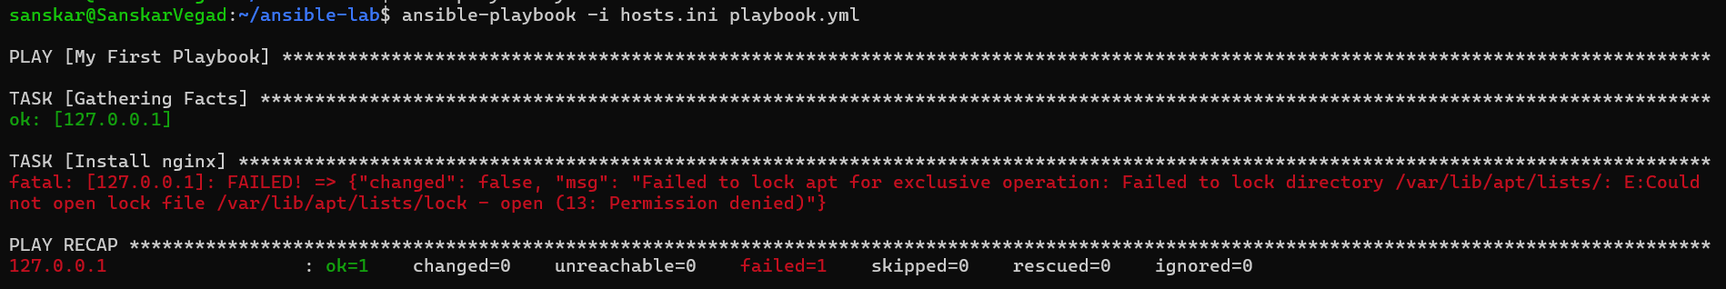
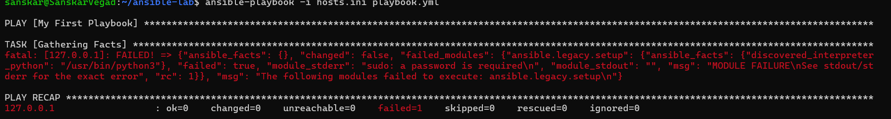
You might face these errors:
1] Enable become: yes in your playbook
name: My First Playbook
hosts: local
become: yes # <-- this is the key line
tasks:
- name: Install nginx
…….continue
2] Bypass Password
Option 1: ansible-playbook -i hosts.ini playbook.yml --ask-become-pass
Option 2: sudo visudo
sanskar ALL=(ALL) NOPASSWD:ALL

Slide 29
Ansible vs Chef vs Puppet
Feature | Ansible | Chef | Puppet
Language | YAML | Ruby DSL | Puppet DSL (Ruby-like)
Architecture | Agentless (push) | Agent (pull) | Agent (pull)
Learning Curve | Easy | Hard | Medium
Style | Declarative + procedural | Procedural | Declarative
Best For | Automation, CI/CD | Complex environments | Large enterprises

Slide 30

Conclusion & Next Steps
Embracing configuration management and automation is no longer optional; it's essential for competitive and reliable software delivery.
Automate Everything
Scalability & Consistency
From infrastructure provisioning to application deployment, automation reduces errors and speeds up delivery.
Ensure environments are identical and can scale effortlessly with tools like Ansible and GitHub Actions.
Resources:
Ansible Documentation
GitHub Actions Documentation
Harness Continuous Delivery
Q&A

